Slide 1


Comparative Study of Three DNA-based information hiding methods
College of Computer Sciences and information technology
Imam University, Saudi Arabia
By:
Maimounah Albrahim
Nisreen Terkawi
Wafaa alSaffar
Supervisor:
Dr. Amjad Ail Al- amar

Slide 2
Outline
Interdiction
Background
Related Work
Methodology
Result
Conclusion
Future Work
References

Slide 3
1. Interdiction
Interdiction
Background
Related Work
Methodology
Result
Conclusion
Future Work
References
Problem definition: this project answers the following questions:
What is the steganography field?
What are the features of our project?
Why our work is helpful?
How we measured the algorithm performance?
What is the best algorithm to use between the three algorithms?
What is the result of measuring algorithms?
3

Slide 4
1. Interdiction
Interdiction
Background
Related Work
Methodology
Result
Conclusion
Future Work
References
Aim and Objective:
The main aim is comparing three steganography algorithms based on DNA depends on the following features: capacity, cracking probability, BPN, and also modification rates.
The objectives are:
1. Survey existing DNA-based steganography algorithms.
2. Implement selected algorithms.
3. Compare these algorithms based on specified comparison measurements.
4. Analyze the comparison results.
5. Evaluate these results.
4

Slide 5
1. Interdiction
Interdiction
Background
Related Work
Methodology
Result
Conclusion
Future Work
References
Cracking probability:
It is the total probability to predict the confidential information hidden inside the reference DNA sequence.
Capacity:
It is the total length of increased DNA sequence after the appealing steganography algorithm.
Bit Per Nucleate (BPN):
It is total number of bits hidden per nucleate.
modification rates(Payload):
It is the length of the new sequence after the extracting the reference DNA sequence.
5
5

Slide 6
2. Background
Interdiction
Background
Related Work
Methodology
Result
Conclusion
Future Work
References
Steganography Vs Cryptography
Cryptography | Steganography
convert any type of data into an unreadable format | hiding a secret message within a cover media | Definition
Data protection | Secure communication | Purpose
Always visible | Not visible at never | Visibility
Necessary | Optional | Key
6

Slide 7
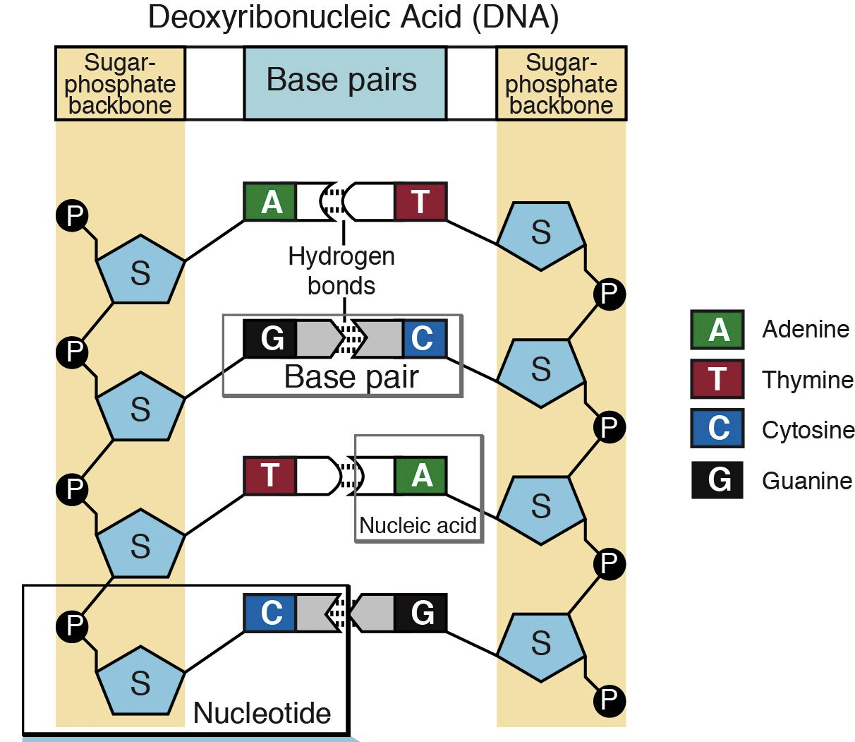
2. Background
Interdiction
Background
Related Work
Methodology
Result
Conclusion
Future Work
References
Deoxyribonucleic acid (DNA): is a molecule composed of two chains that coil around each other to form a double helix carrying genetic instructions.
The two DNA strands are composed of simpler monomeric units called nucleotides. Each nucleotide is composed of one of four nitrogen-containing nucleobases (cytosine [C], guanine [G], adenine [A] or thymine [T]).
7

Slide 8
3. Related Work
Interdiction
Background
Related Work
Methodology
Result
Conclusion
Future Work
References
Based on our research there are a lot of proposed DNA-based steganography algorithms. Here in the following table we randomly summarize three examples of them.
Related paper | Secret Text Type | Used Binary Coding Rule | Encryption Algorithm | Data Hiding Methodology | Blind/ Not Blind
[1] | G.Hamed et al | Any type of data. | 4-bits binary coding rule. | Encryption used DNA and amino acids based Playfair cipher, 5*5 matrix. | LSB substitution.
[2] | A. Khalifa et al | Any type of data. | N-bits binary coding rule. | Encryption used DNA and amino acids based Playfair cipher. | Combine Substitution method and Insertion method.
[3] | Malathi et al | Any type of data. | 2-bit binary coding rule. | Use XOR cipher | Insertion method.

Slide 9
4. Methodology
Interdiction
Background
Related Work
Methodology
Result
Conclusion
Future Work
References
Our algorithms are:
LSB Substitution.
Insertion.
Complementary Generic Substitution and Insertion.
Notes:
I am Haifa Almutairi and I will discuss the methodology for this project. The IFN/ENIT database will be used as a corpus of our project. This picture shows the stages of our model.
Firstly, we will have two separate models one based on ACO and the other on PSO. Two preprocessing techniques will be applied. These techniques are binarization and diacritics removal. Then, the window positioning algorithm will be used to segment the images.
After the segmentation stage, informative features will be extracted from each segment. Therefore, these features will be selected empirically by using ACO and PSO algorithms.
Then, the features will form a code vector which represents the segment. All of these vectors will construct the Writer specific Codebook.
Euclidian distance will be used to compute the distance between the codebook for two samples. According to the threshold value, we can decide if these documents belong to the same writer or not.
Finally, we will compare the performance of the models.

Slide 10
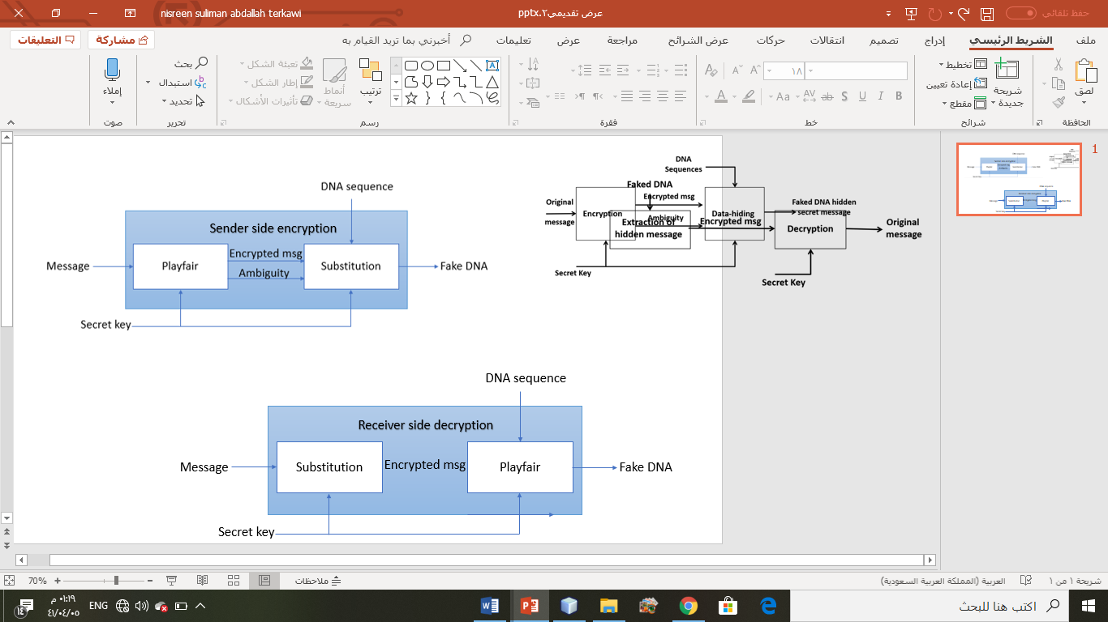
4. Methodology
Interdiction
Background
Related Work
Methodology
Result
Conclusion
Future Work
References
First Algorithm (LSB Substitution).
Notes:
I am Haifa Almutairi and I will discuss the methodology for this project. The IFN/ENIT database will be used as a corpus of our project. This picture shows the stages of our model.
Firstly, we will have two separate models one based on ACO and the other on PSO. Two preprocessing techniques will be applied. These techniques are binarization and diacritics removal. Then, the window positioning algorithm will be used to segment the images.
After the segmentation stage, informative features will be extracted from each segment. Therefore, these features will be selected empirically by using ACO and PSO algorithms.
Then, the features will form a code vector which represents the segment. All of these vectors will construct the Writer specific Codebook.
Euclidian distance will be used to compute the distance between the codebook for two samples. According to the threshold value, we can decide if these documents belong to the same writer or not.
Finally, we will compare the performance of the models.

Slide 11
Interdiction
Background
Related Work
Methodology
Result
Conclusion
Future Work
References
Message
Use 8-bits to convert to binary
M_{bin}
Use 4-bits binary coding rule to convert to DNA
M_{DNA}
Convert to Amino Acid
M_{AA} & Ambiguity
Secret Key
Encrypt by PlayFair
Cipher M_{AA}
Convert to DNA
Cipher M_{DNA}
Convert to binary
Cipher M_{Bin}
Notes:
I am Haifa Almutairi and I will discuss the methodology for this project. The IFN/ENIT database will be used as a corpus of our project. This picture shows the stages of our model.
Firstly, we will have two separate models one based on ACO and the other on PSO. Two preprocessing techniques will be applied. These techniques are binarization and diacritics removal. Then, the window positioning algorithm will be used to segment the images.
After the segmentation stage, informative features will be extracted from each segment. Therefore, these features will be selected empirically by using ACO and PSO algorithms.
Then, the features will form a code vector which represents the segment. All of these vectors will construct the Writer specific Codebook.
Euclidian distance will be used to compute the distance between the codebook for two samples. According to the threshold value, we can decide if these documents belong to the same writer or not.
Finally, we will compare the performance of the models.

Slide 12
R N A
This step In Details:
First convert to ASCII code:
ASCII (R)= 82
ASCII (N)= 78
ASCII (A)= 65
01010010 01001110 01000001

Slide 13
R N A
0101 0010 0100 1110 0100 0001
DNA Nucleotides | Binary Representation | DNA Nucleotides | Binary Representation
AA | 0000 | GG | 1000
AC | 0001 | GA | 1001
AG | 0010 | GC | 1010
AT | 0011 | GT | 1011
CC | 0100 | TT | 1100
CA | 0101 | TA | 1101
CG | 0110 | TC | 1110
CT | 0111 | TG | 1111
CAAGCCTCCCAC

Slide 14
R N A
UUA, UUG | O | GCU, GCC, GCA, GCG | A
CCU, CCC, CCA, CCG | P | UAA, UGA, UAG | B
CAA, CAG | Q | UGU, UGC | C
CGU, CGC, CGA, CGG | R | GAU, GAC | D
UCU, UCC, UCA, UCG | S | GAA, GAG | E
ACU, ACC, ACA, ACG | T | UUU, UUC | F
AGA, AGG | U | GGU, GGC, GGA, GGG | G
GUU, GUC, GUA, GUG | V | CAU, CAC | H
UGG | W | AUU, AUC, AUA | I
AGU, AGC | X | AAA, AAG | K
UAU | Y | CUU, CUC, CUA, CUG | L
UAC | Z | AUG | M
 |  | AAU, AAC | N
0101 0010 0100 1110 0100 0001
CAAGCCUCCCAC
Q A S H
0 1 1 1
standard universal table of the distribution of the alphabet with their corresponding codons

Slide 15
R N A
0101 0010 0100 1110 0100 0001
R | U | C | E | S
B | A | Y | T | I
K | H | G | F | D
P | O | N | M | L
Z | X | W | V | Q
CAAGCCTCCCAC
Q A S H
0 1 1 1
X I U D
0 0 0 0

Slide 16
R N A
UUA, UUG | O | GCU, GCC, GCA, GCG | A
CCU, CCC, CCA, CCG | P | UAA, UGA, UAG | B
CAA, CAG | Q | UGU, UGC | C
CGU, CGC, CGA, CGG | R | GAU, GAC | D
UCU, UCC, UCA, UCG | S | GAA, GAG | E
ACU, ACC, ACA, ACG | T | UUU, UUC | F
AGA, AGG | U | GGU, GGC, GGA, GGG | G
GUU, GUC, GUA, GUG | V | CAU, CAC | H
UGG | W | AUU, AUC, AUA | I
AGU, AGC | X | AAA, AAG | K
UAU | Y | CUU, CUC, CUA, CUG | L
UAC | Z | AUG | M
 |  | AAU, AAC | N
0101 0010 0100 1110 0100 0001
CAAGCCTCCCAC
Q A S H
0 1 1 1
X I U D
0 0 0 0
AGUAUUAGAGAU

Slide 17
R N A
0101 0010 0100 1110 0100 0001
DNA Nucleotides | Binary Representation | DNA Nucleotides | Binary Representation
AA | 0000 | GG | 1000
AC | 0001 | GA | 1001
AG | 0010 | GC | 1010
AT | 0011 | GT | 1011
CC | 0100 | TT | 1100
CA | 0101 | TA | 1101
CG | 0110 | TC | 1110
CT | 0111 | TG | 1111
CAAGCCTCCCAC
Q A S H
0 1 1 1
X I U D
0 0 0 0
AGTATTAGAGAT
0010 1101 1100 0010 0010 0011

Slide 18
R N A
0101 0010 0100 1110 0100 0001
CAAGCCTCCCAC
Convert Ambiguity to Binary
Q A S H
0 1 1 1
00 01 01 01
X I U D
0 0 0 0
Decimal | Binary representation
0 | 00
1 | 01
2 | 10
3 | 11
AGTATTAGAGAT
001011011100001000100011

Slide 19
R N A
0101 0010 0100 1110 0100 0001
The information we must hide in DNA are:
CAAGCCTCCCAC
Binary Ambiguity
Q A S H
0 1 1 1
00010101
X I U D
0 0 0 0
Cipher Binary Message
001011011100001000100011
AGTATTAGAGAT
001011011100001000100011

Slide 20
LSB Substitution:
Binary bits of cipher Message and Ambiguity
DNA reference sequence
Check LSB of each codon of S :
Substitute purine base (A or G) with A to encode 0 and G to encode 1.
Substitute pyrimidine (T or C) with T to encode 0 and C to encode 1.
Faked DNA reference sequence
The innovation idea 3:1 ratio used to hide 3 bits of binary cipher message followed by 1 bit of binary ambiguity.
Notes:
I am Haifa Almutairi and I will discuss the methodology for this project. The IFN/ENIT database will be used as a corpus of our project. This picture shows the stages of our model.
Firstly, we will have two separate models one based on ACO and the other on PSO. Two preprocessing techniques will be applied. These techniques are binarization and diacritics removal. Then, the window positioning algorithm will be used to segment the images.
After the segmentation stage, informative features will be extracted from each segment. Therefore, these features will be selected empirically by using ACO and PSO algorithms.
Then, the features will form a code vector which represents the segment. All of these vectors will construct the Writer specific Codebook.
Euclidian distance will be used to compute the distance between the codebook for two samples. According to the threshold value, we can decide if these documents belong to the same writer or not.
Finally, we will compare the performance of the models.

Slide 21
Inputs:
Binary Ambiguity
Cipher Binary Message
DNA reference sequence
00
001011
AACTAGGGACATACGTACCGTTTA
TTA | GGT | TAC | ACG | CAT | GGA | TAG | AAC | Row 1
A | T | C | G | T | A | G | C | Row 2
Pur | Pyr. | Pyr. | Pur. | Pyr. | Pur. | Pur. | Pyr. | Row 3
 | 1 | 1 | 0 |  | 1 | 0 | 0 | Row 4
0 |  |  |  | 0 |  |  |  | Row 5
A | C | C | A | T | G | A | T | Row 6
TTA | GGC | TAC | ACA | CAT | GGG | TAA | AAT | Row 7

Slide 22
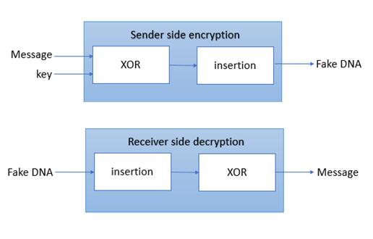
4. Methodology
Interdiction
Background
Related Work
Methodology
Result
Conclusion
Future Work
References
Second Algorithm (insertion).
22

Slide 23

Interdiction
Background
Related Work
Methodology
Result
Conclusion
Future Work
References
Message
Use 8-bits ASCII to convert to binary
M_{bin}
Secret Key
A
Use 2-bits binary coding rule to convert to DNA
A_{DNA}
Convert to Protein
A_{RNA}
Convert to binary
Cipher M_{Bin}
23

Slide 24
R N A
This step In Details:
First convert to ASCII code:
ASCII (R)= 82
ASCII (N)= 78
ASCII (A)= 65
01010010 01001110 01000001

Slide 25
R N A
01 01 00 10 01 00 11 10 01 00 00 01
DNA Nucleotides | Decimal Representation | Binary Representation
A | 1 | 00
C | 2 | 01
G | 3 | 10
T | 4 | 11
CCAGCATGCAAC
GGUCGUACGUUG
Then covert to binary put the result is variable value depend on the random key value (ABIN).
25

Slide 26
ABIN
DNA reference sequence
Convert to binary.
Spilt into parts.
Insert bit by bit of ADNA into the sequence parts.
Faked DNA reference sequence
26

Slide 27
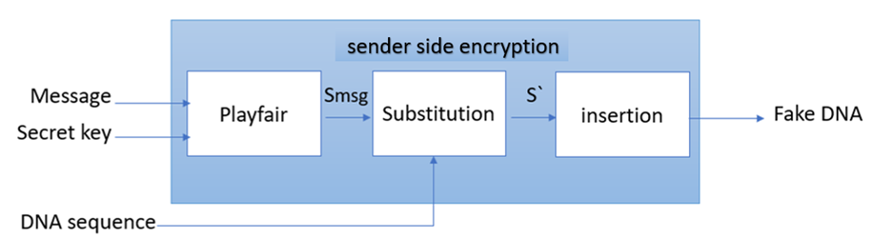
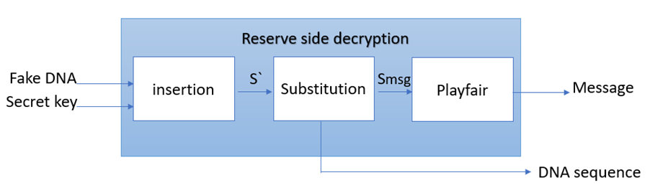
4. Methodology
Interdiction
Background
Related Work
Methodology
Result
Conclusion
Future Work
References
Third Algorithm (Generic complementary substitution).
27

Slide 28
Interdiction
Background
Related Work
Methodology
Result
Conclusion
Future Work
References
Message
Use 8-bits to convert to binary
S_{m}
Use 2-bits binary coding rule to convert to DNA
S_{dna} + S_{amb}
Convert to Amino Acid
S_{Amino}
Secret Key
Encrypt by PlayFair
S_{Enc} & S_{amb}
Convert to DNA
Cipher S_{msg}
Substitution phase
S’
S’’
Insertion phase
Notes:
I am Haifa Almutairi and I will discuss the methodology for this project. The IFN/ENIT database will be used as a corpus of our project. This picture shows the stages of our model.
Firstly, we will have two separate models one based on ACO and the other on PSO. Two preprocessing techniques will be applied. These techniques are binarization and diacritics removal. Then, the window positioning algorithm will be used to segment the images.
After the segmentation stage, informative features will be extracted from each segment. Therefore, these features will be selected empirically by using ACO and PSO algorithms.
Then, the features will form a code vector which represents the segment. All of these vectors will construct the Writer specific Codebook.
Euclidian distance will be used to compute the distance between the codebook for two samples. According to the threshold value, we can decide if these documents belong to the same writer or not.
Finally, we will compare the performance of the models.

Slide 29
R N A
This step In Details:
First convert to ASCII code:
ASCII (R)= 82
ASCII (N)= 78
ASCII (A)= 65
01010010 01001110 01000001

Slide 30
R N A
0101 0010 0100 1110 0100 0001
DNA Nucleotides | Binary Representation
A | 00
C | 01
G | 10
T | 11
CCAGCATGCAAC

Slide 31
R N A
TTA, TTG | O | GCT, GCC, GCA, GCG | A
CCT, CCC, CCA, CCG | P | TAA, TGA, TAG | B
CAA, CAG | Q | TGT, TGC | C
CGT, CGC, CGA, CGG | R | GAT, GAC | D
TCT, TCC, TCA, TCG | S | GAA, GAG | E
ACT, ACC, ACA, ACG | T | TTT, TTC | F
AGA, AGG | U | GGT, GGC, GGA, GGG | G
GTT, GTC, GTA, GTG | V | CAT, CAC | H
TGG | W | ATT, ATC, ATA | I
AGT, AGC | X | AAA, AAG | K
TAT | Y | CTT, CTC, CTA, CTG | L
TAC | Z | ATG | M
 |  | AAT, AAC | N
0101 0010 0100 1110 0100 0001
CCAGCATGCAAC
P A C N
2 2 1 1
standard universal table of the distribution of the alphabet with their corresponding codons

Slide 32
R N A
0101 0010 0100 1110 0100 0001
R | U | C | E | S
B | A | Y | T | I
K | H | G | F | D
P | O | N | M | L
Z | X | W | V | Q
CCAGCATGCAAC
P A C N
2 2 1 1
O B W G
0 0 0 0

Slide 33
R N A
TTA, TTG | O | GCT, GCC, GCA, GCG | A
CCT, CCC, CCA, CCG | P | TAA, TGA, TAG | B
CAA, CAG | Q | TGT, TGC | C
CGT, CGC, CGA, CGG | R | GAT, GAC | D
TCT, TCC, TCA, TCG | S | GAA, GAG | E
ACT, ACC, ACA, ACG | T | TTT, TTC | F
AGA, AGG | U | GGT, GGC, GGA, GGG | G
GTT, GTC, GTA, GTG | V | CAT, CAC | H
TGG | W | ATT, ATC, ATA | I
AGT, AGC | X | AAA, AAG | K
TAT | Y | CTT, CTC, CTA, CTG | L
TAC | Z | ATG | M
 |  | AAT, AAC | N
0101 0010 0100 1110 0100 0001
CCAGCATGCAAC
P A C N
2 2 1 1
O B W G
0 0 0 0
TTAGTAAGTGGC
GGTC

Slide 34
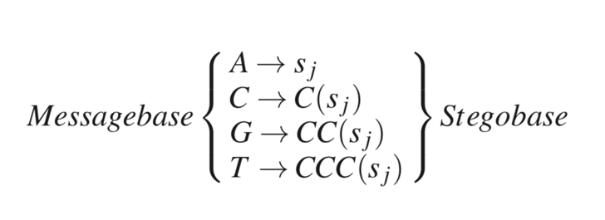
Substitution step rules .
use this tables to complement the remain steps (Substitution)
A Generic base paring
Base | Complement
A | C
C | T
G | A
T | G

Slide 35
5. Result
Interdiction
Background
Related Work
Methodology
Result
Conclusion
Future Work
References
Comparison of capacity measurement
Notes:
I am Haifa Almutairi and I will discuss the methodology for this project. The IFN/ENIT database will be used as a corpus of our project. This picture shows the stages of our model.
Firstly, we will have two separate models one based on ACO and the other on PSO. Two preprocessing techniques will be applied. These techniques are binarization and diacritics removal. Then, the window positioning algorithm will be used to segment the images.
After the segmentation stage, informative features will be extracted from each segment. Therefore, these features will be selected empirically by using ACO and PSO algorithms.
Then, the features will form a code vector which represents the segment. All of these vectors will construct the Writer specific Codebook.
Euclidian distance will be used to compute the distance between the codebook for two samples. According to the threshold value, we can decide if these documents belong to the same writer or not.
Finally, we will compare the performance of the models.

Slide 36
5. Result
Interdiction
Background
Related Work
Methodology
Result
Conclusion
Future Work
References
Comparison of Payload measurement
Notes:
I am Haifa Almutairi and I will discuss the methodology for this project. The IFN/ENIT database will be used as a corpus of our project. This picture shows the stages of our model.
Firstly, we will have two separate models one based on ACO and the other on PSO. Two preprocessing techniques will be applied. These techniques are binarization and diacritics removal. Then, the window positioning algorithm will be used to segment the images.
After the segmentation stage, informative features will be extracted from each segment. Therefore, these features will be selected empirically by using ACO and PSO algorithms.
Then, the features will form a code vector which represents the segment. All of these vectors will construct the Writer specific Codebook.
Euclidian distance will be used to compute the distance between the codebook for two samples. According to the threshold value, we can decide if these documents belong to the same writer or not.
Finally, we will compare the performance of the models.

Slide 37
5. Result
Interdiction
Background
Related Work
Methodology
Result
Conclusion
Future Work
References
Comparison of BPN measurement
Notes:
I am Haifa Almutairi and I will discuss the methodology for this project. The IFN/ENIT database will be used as a corpus of our project. This picture shows the stages of our model.
Firstly, we will have two separate models one based on ACO and the other on PSO. Two preprocessing techniques will be applied. These techniques are binarization and diacritics removal. Then, the window positioning algorithm will be used to segment the images.
After the segmentation stage, informative features will be extracted from each segment. Therefore, these features will be selected empirically by using ACO and PSO algorithms.
Then, the features will form a code vector which represents the segment. All of these vectors will construct the Writer specific Codebook.
Euclidian distance will be used to compute the distance between the codebook for two samples. According to the threshold value, we can decide if these documents belong to the same writer or not.
Finally, we will compare the performance of the models.

Slide 38
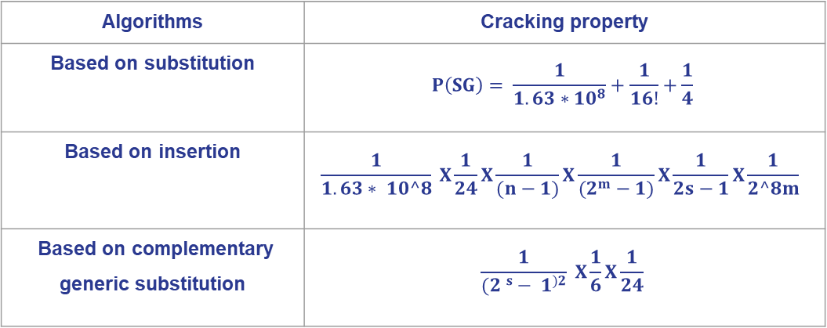
5. Result
Interdiction
Background
Related Work
Methodology
Result
Conclusion
Future Work
References
The result of cracking property for each algorithm:
Algorithms | Cracking property
Based on substitution | $$P\left(SG\right)= \frac{1}{1.63∗{10}^{8}}+\frac{1}{16!}+\frac{1}{4}$$
Based on insertion | $$\frac{1}{1.63∗ 10^8} X\frac{1}{24}X\frac{1}{(n−1)}X\frac{1}{(2^{m}−1)}X\frac{1}{2s−1}X\frac{1}{2^8m}$$
Based on complementary generic substitution | $$\frac{1}{(2 ^{s}− 1^{)2}} X\frac{1}{6}X\frac{1}{24}$$
Notes:
I am Haifa Almutairi and I will discuss the methodology for this project. The IFN/ENIT database will be used as a corpus of our project. This picture shows the stages of our model.
Firstly, we will have two separate models one based on ACO and the other on PSO. Two preprocessing techniques will be applied. These techniques are binarization and diacritics removal. Then, the window positioning algorithm will be used to segment the images.
After the segmentation stage, informative features will be extracted from each segment. Therefore, these features will be selected empirically by using ACO and PSO algorithms.
Then, the features will form a code vector which represents the segment. All of these vectors will construct the Writer specific Codebook.
Euclidian distance will be used to compute the distance between the codebook for two samples. According to the threshold value, we can decide if these documents belong to the same writer or not.
Finally, we will compare the performance of the models.

Slide 39
5. Result
Interdiction
Background
Related Work
Methodology
Result
Conclusion
Future Work
References
From a comparison of algorithms that each algorithm has its strength features and the target system should be consider it when choose the suitable algorithm.
The LSB based algorithm is better than the other in term of BPN and payload.
The complementary generic substitution-based algorithm is better in term of capacity.
Whereas the insertion-based algorithm provides low cracking property.
Notes:
I am Haifa Almutairi and I will discuss the methodology for this project. The IFN/ENIT database will be used as a corpus of our project. This picture shows the stages of our model.
Firstly, we will have two separate models one based on ACO and the other on PSO. Two preprocessing techniques will be applied. These techniques are binarization and diacritics removal. Then, the window positioning algorithm will be used to segment the images.
After the segmentation stage, informative features will be extracted from each segment. Therefore, these features will be selected empirically by using ACO and PSO algorithms.
Then, the features will form a code vector which represents the segment. All of these vectors will construct the Writer specific Codebook.
Euclidian distance will be used to compute the distance between the codebook for two samples. According to the threshold value, we can decide if these documents belong to the same writer or not.
Finally, we will compare the performance of the models.

Slide 40
6. Conclusion
Interdiction
Background
Related Work
Methodology
Result
Conclusion
Future Work
References
Compare three DNA-based steganography with encryption algorithms in term of capacity, payload, BPN, and cracking property
The three algorithms are by using substitution, by using insertion, and the last by using complementary generic substitution.
Encryption in the specified algorithms are Playfair and XOR.
As a result, it turns out that the algorithms we noticed that each algorithm has advantages and disadvantages based on measurements.
Notes:
This project introduces a new verification model named an off-line Arabic handwriting verification model for forensic scientists. This model is based on ACO and PSO algorithms which are effective algorithms on design optimization problem. To the best of our knowledge, none of the previous studies applied SI algorithms for features selection in offline Arabic handwriting verification problem.
Thank you any question!.

Slide 41
7. Future Work
Interdiction
Background
Related Work
Methodology
Result
Conclusion
Future Work
References
we are thinking about extending this project by creating a new steganography method better than and stronger than others, by combining more than one algorithm, to obtain more secure data at exchanging it.
we can improve and overcome some of the limitations we found during our implementation of the selected algorithm.
we can examine the selected algorithm with a different encryption algorithm and study the effect of that on the new proposed algorithm.
We are thinking about studying more steganography algorithms and make comparisons among them to clarify their advantages and their disadvantages then combine different algorithms to propose a new better algorithm that inherent the strength of each algorithm.
Notes:
This project introduces a new verification model named an off-line Arabic handwriting verification model for forensic scientists. This model is based on ACO and PSO algorithms which are effective algorithms on design optimization problem. To the best of our knowledge, none of the previous studies applied SI algorithms for features selection in offline Arabic handwriting verification problem.
Thank you any question!.

Slide 42
Questions!

Slide 43
8. References
Interdiction
Background
Related Work
Methodology
Result
Conclusion
Future Work
References
[1] G. Hamed, M. Marey, S. A. El-Sayed, and M. F. Tolba, “Hybrid technique for steganography-based on DNA with n-bits binary coding rule,” 2015 7th International Conference of Soft Computing and Pattern Recognition (SoCPaR), 2015.
[2] M. P, M. M, M. R, V. Raghavan, and V. R.e., ‘Highly Improved DNA Based Steganography’, Procedia Comput. Sci., vol. 115, pp. 651–659, Jan. 2017.
[3] A. Khalifa, A. Elhadad, and S. Hamad, “Secure Blind Data Hiding into Pseudo DNA Sequences Using Playfair Ciphering and Generic Complementary Substitution,” Applied Mathematics & Information Sciences, vol. 10, no. 4, pp. 1483–1492, Jan. 2016.
[4] https://www.google.com/url?sa=i&url=https%3A%2F%2Fknowgenetics.org%2Fnucleotides-and-bases%2F&psig=AOvVaw3mvsmKhbBV5bAyDDi5K10b&ust=1576009432673000&source=images&cd=vfe&ved=0CAIQjRxqFwoTCICdme2yqeYCFQAAAAAdAAAAABAj

Slide 44


